Slide 1
Detecting heavy industry in Sentinel imagery

Slide 2
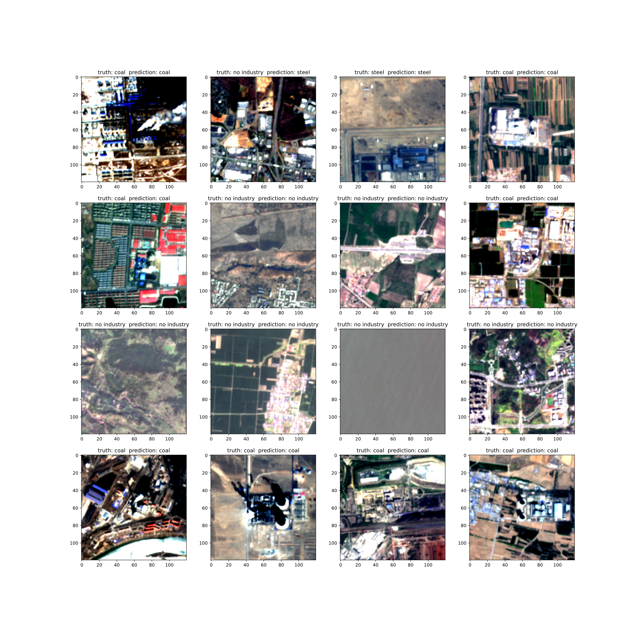

Slide 3
Model metrics ResNet50v2
Precision recall f1-score support
coal 0.95 0.92 0.94 197
steel 0.90 0.91 0.91 189
other 0.95 0.95 0.95 396
accuracy 0.94 782
Trained on 80% of ~8000 samples
Confusion matrices
[[[0.74 0.01] coal
[0.02 0.23]]
[[0.73 0.02] steel
[0.02 0.22]]
[[0.47 0.03] other
[0.02 0.48]]]

Slide 4
Success!

Slide 5
Misclassified: other industry

Slide 6
Misclassified: river

Slide 7
Misclassified: urban fabric

Slide 8
Misclassified: cloud

Slide 9
Next steps to avoid false positives
For category cloud: use other sentinel overpass and compare
For river, industry, urban fabric: need higher resolution

Slide 10
Problem:
False positive when a negative is wrongly classified
P(negative) = negative fraction
P(wrong classification of negative) = P(class pos I neg) = 1-precision
Where precision is P(positive classification is true positive) = P(pos I class pos)
False Positive rate = (1-precision) * negative fraction
In training/eval: precision ~0.9, negative fraction ~0.5
In deployment to sentinel tiles: precision <0.9, negative fraction ~0.99
Many more non-industry tiles in real world data, so non-perfect precision yields many false positives

